Slide 1
איפיון מוצר
שם האפליקציה: Morello
חברי הצוות: נדב מורג, איריס אורון

Slide 2
Main Pages

Slide 3
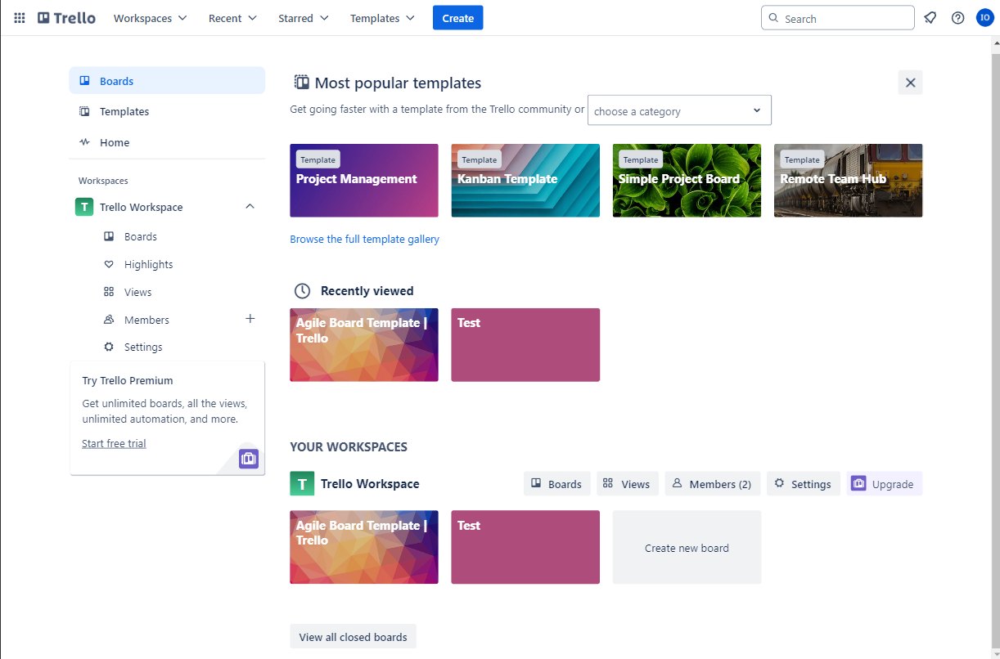
Boards page

Slide 4
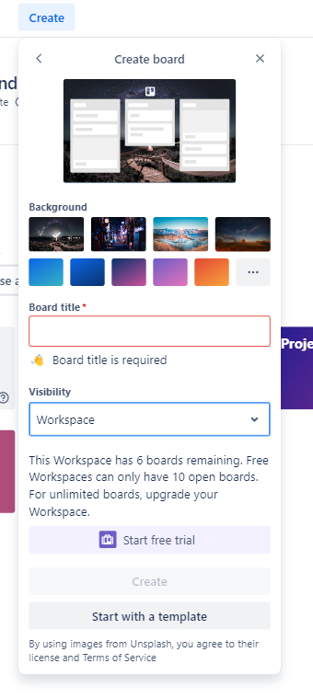
Create board modal

Slide 5
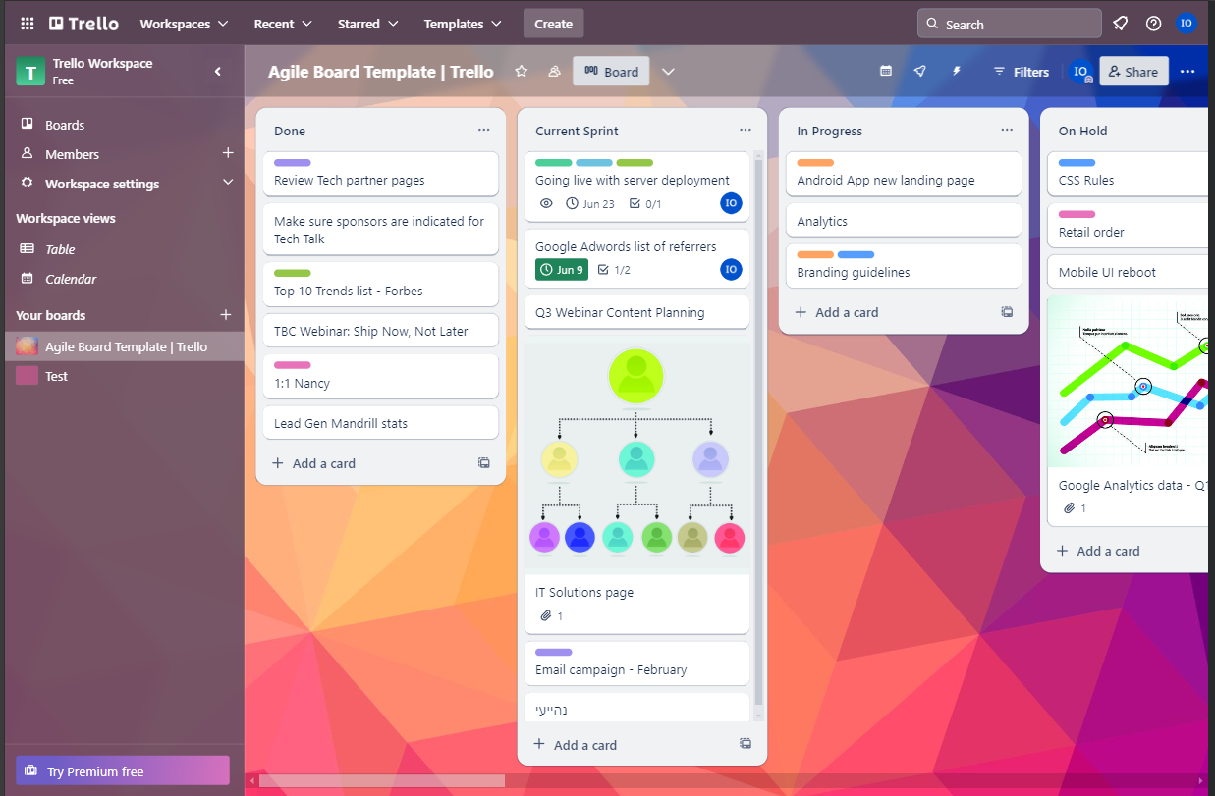
Tasks page

Slide 6
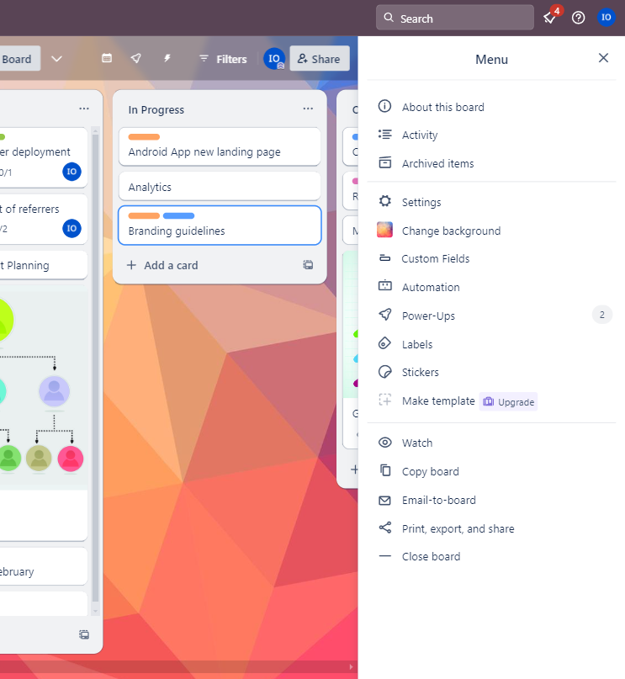
Tasks page menu
Delete

Slide 7
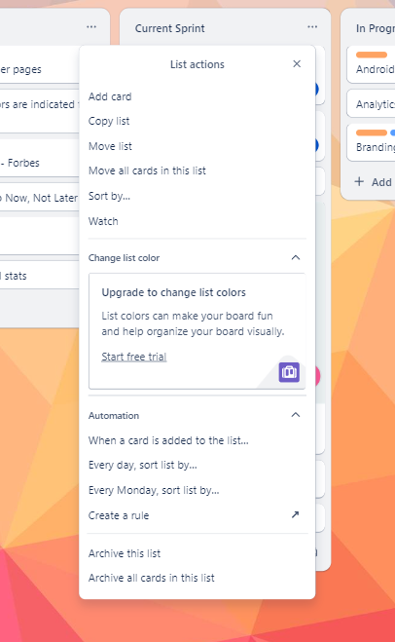
Group menu

Slide 8
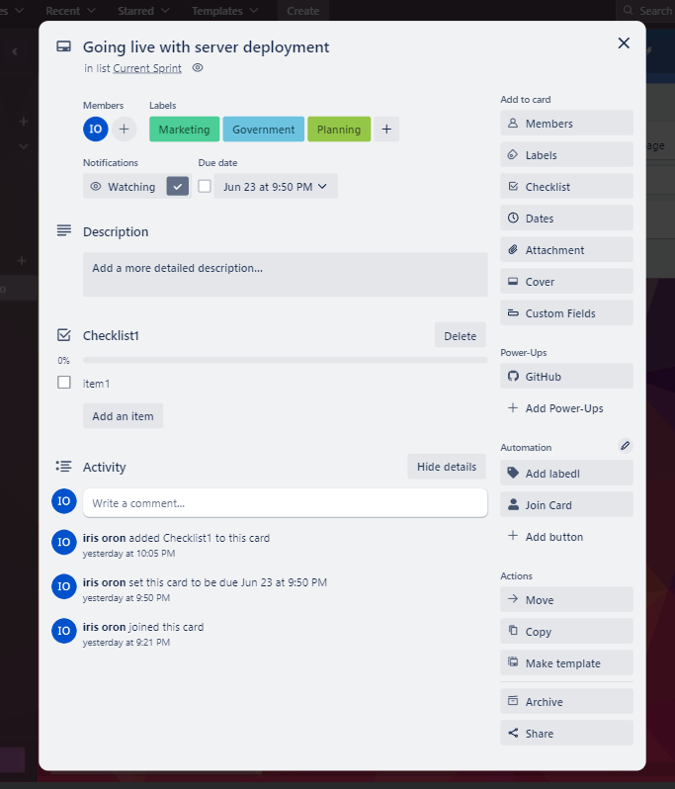
Task details

Slide 9
Entities

Slide 10
Entities
Nice to have:
Board
List = Group
Card = Task:
Comment
Checklist+Todo
Attachment
Member
Label
Action
Activity

Slide 11
Main Flows

Slide 12
Flow
Homepage + Authentication
Boards page
Board
Task (card)

Slide 13
Add board
From the boards page click create
Enter name, visibility, background image
Click create

Slide 14
Flow

Slide 15
Backoffice
None

